Slide 1
Chemistry – Oct 8, 2019
P3 Challenge-
  Pretend you need to separate a mixture of sand, iron filing and salt. Briefly describe the strategy you will use to separate these three substances using a flow chart.
Objective –
  Kinetic Theory of Gases
  Pressure, Temperature, and PT Diagrams

Slide 2
Chemistry – Oct 8, 2019
Agenda –
  Kinetic Molecular Theory of Gases
  Temperature units
  Pressure and Pressure units
  Standard Temperature and Pressure (STP)
  Phase Diagrams
Assignment: -
  Pressure- Temperature Worksheet
  Complete the Separation Lab report, due Thurs 10/10

Slide 3
Kinetic Theory of Gases
1) A gas is a collection of particles in continuous, random motion with constant velocity (constant speed in straight-line motion, though not all will have the same velocity)
2) There is a lot of empty space between gas particles compared to the size of the particles. (In addition, particles will be distributed evenly)
3) Gas particles do not attract or repel each other – they do not interact (there are no internal forces)
4) Collisions of particles with one another or the walls of a container are elastic. (like billiard balls – both momentum and energy are conserved in these collisions.)
5) Temperature (in K) is a measure of the average kinetic energy of the particles. (Note: gas collisions transfer energy but do not change the average kinetic energy. No motion = 0 K, Absolute zero.)

Slide 4
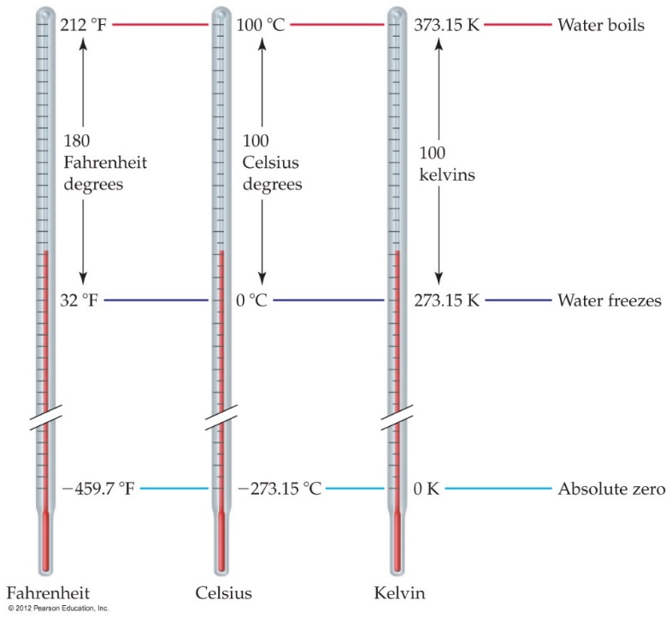
Temperature Scales
Three common temperature scales:
 | Fahrenheit | Celcius | Kelvin
B.P. of water | 212◦F | 100◦C | 373.15 K
Body Temp | 98.6◦F | 37.0◦C | 310.15 K
Room Temp | 68◦F | 20◦C | 293 K
M.P. of water Standard Temp | 32◦F | 0◦C | 273.15 K
Absolute Zero | – 459.7◦F | – 273.15◦C | 0 K

Slide 5
Historical Barometers
Vacuum
Aristotelian belief was that
  air is weightless
  vacuums pull on their surroundings
What is a barometer?
Invert a column of water in a test tube
Same result as a test tube until the tube is 10.3 m (34 ft) tall
Any taller leaves a space above the column of water
No matter how tall you make the tube, the water will rush out of the tube until the water column is 10.3 m tall, leaving a vacuum above the water in the tube.
https://www.youtube.com/watch?v=HUmZrtiXDik World’s Longest Straw
10.3 m

Slide 6
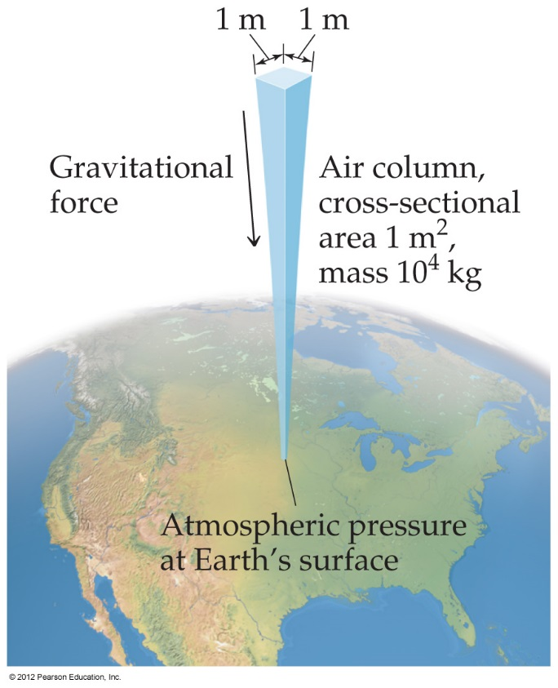
Pressure
Pressure is the amount of force applied to an area:
Atmospheric pressure is the weight of air per unit of area.
F
A
P =

Slide 7
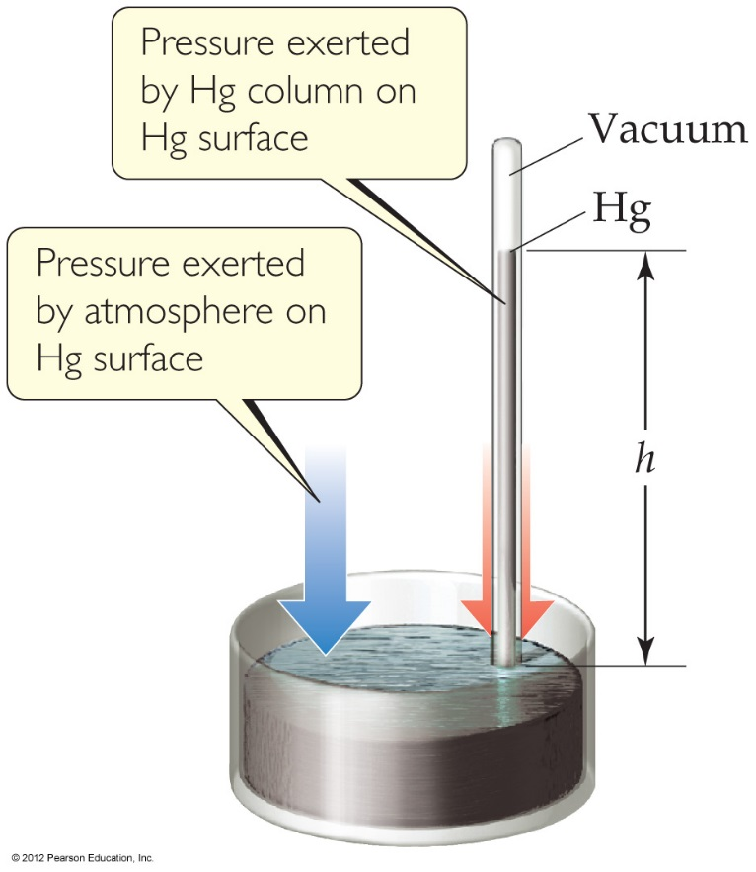
Units of Pressure
Pascals (SI Unit)
  1 Pa = 1 N/m² 1 kPa = 1000 Pa
mmHg or torr
  Height of mercury column
1 Atmosphere= Standard Pressure
  1.00 atm = 760 torr = 101,325 Pa
  English units
    =14.69 pounds per square inch or psi (tires)
    =29.92 inches of Hg (weather reports)
Standard Temperature and Pressure
STP = 1 atm and 0°C

Slide 8
Practice Converting P and T
1.00 atm = 760 torr = 101,325 Pa
Convert 685 mmHg to atm.
Convert 1.20 atm to mmHg
Convert 123 kPa to torr
Convert 30.2” Hg to atm
Convert 38°C to Kelvin
Convert 313 K to Celcius

Slide 9
Simple Gas laws – Explain with KMT
Boyle’s Law – P V
  Pressure increases, volume decreases. Vice versa. T constant.
Charles’ Law – T  V 
  Temperature increases, Volume increases. Vice versa. P constant.
Guy-Lussac’s Law – T  P
  Temperature increases, Pressure increases, Vice versa. V constant.

Slide 10
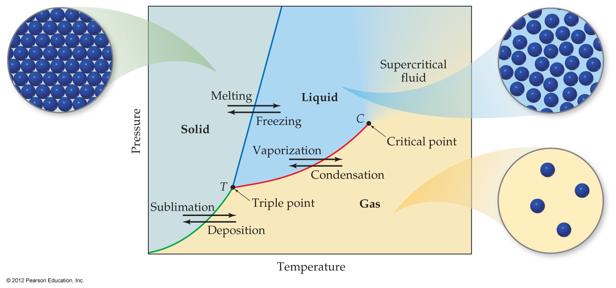
Phase Diagrams
Phase diagrams display the state of a substance at various pressures and temperatures, and the places where equilibria exist between phases.

Slide 11
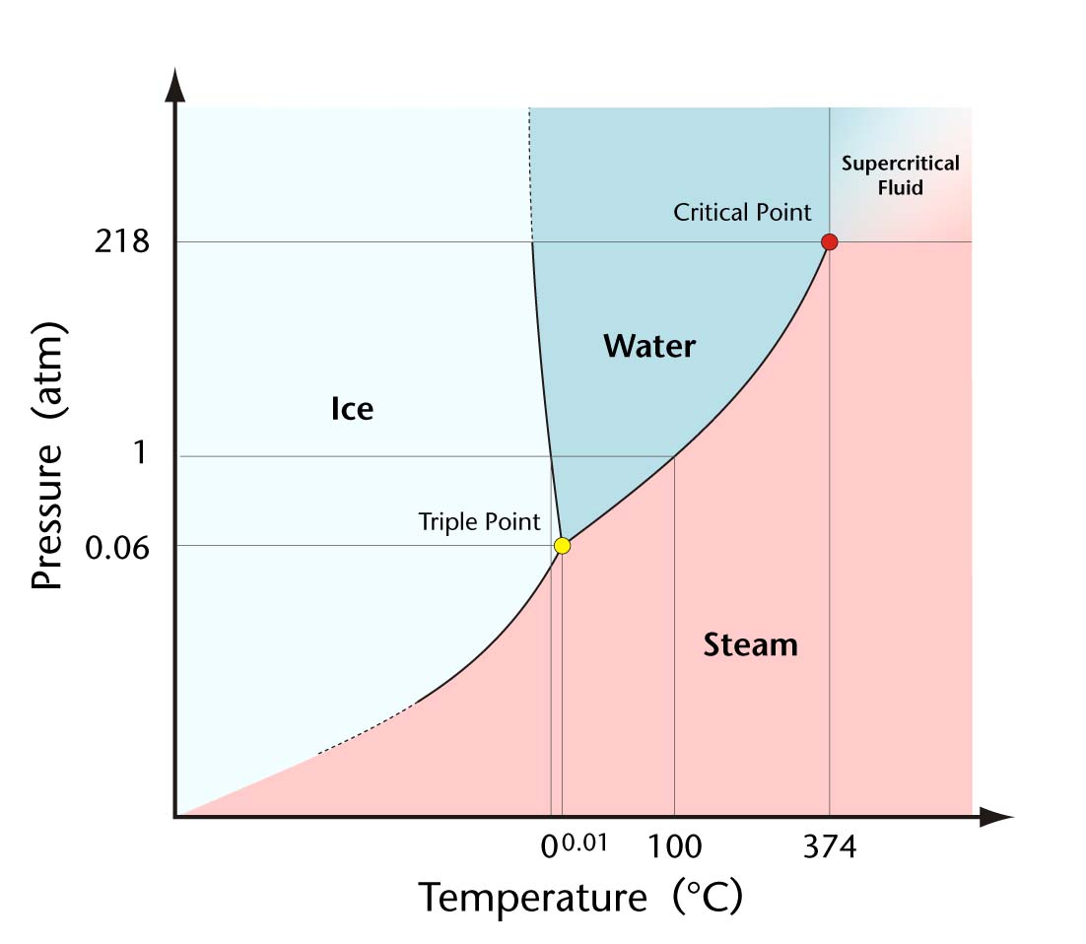
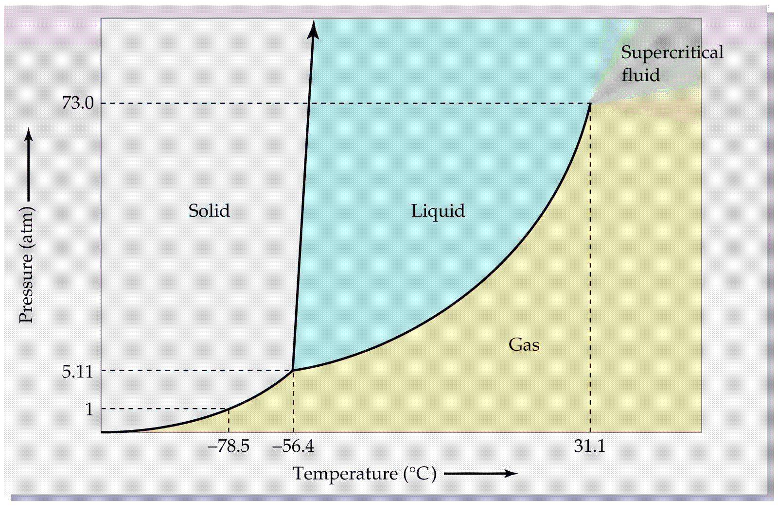
Phase Diagrams for H₂O and CO₂
Triple point of water high speed video

Slide 12
Exit Slip - Homework
Exit Slip: Sketch a basic phase diagram. Label the three states of matter, the triple point and the critical point.
What’s Due? (Pending assignments to complete.)
  Pressure- Temperature Worksheet
  Complete the Separation Lab report
What’s Next? (How to prepare for the next day)
  Energy, p38-45

